Slide 1
Windowing
Pravin Y Pawar

Slide 2
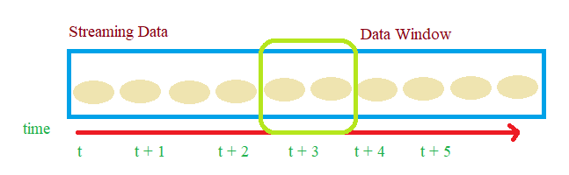
Windows
Defined
Streaming data can not be completely stored in the memory
Then how to process it ?
Windows of data
A certain amount of data that can be processed at a time

Slide 3
Windowing (2)
Policies and Types
Trigger policy
Rules for determining when the code should be executed
Eviction policy
Rules for determining when the data should be evicted from the window
Can be time based or count based
Types
Sliding window
Tumbling window

Slide 4
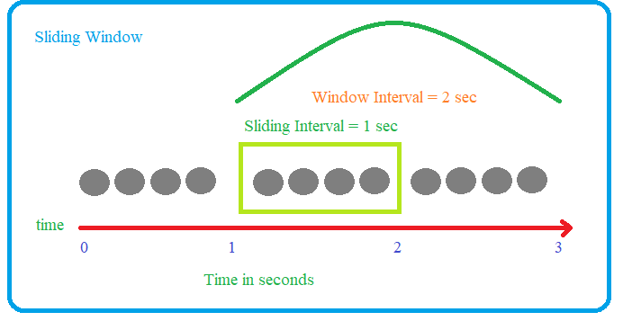
Sliding window
Uses the windowing technique based on time
Window length specifies the eviction policy
Time duration for which data is available for processing
Sliding interval specifies the trigger policy
Time duration after which code will be triggered
If Window length is 2 seconds, then data older
Than 2 seconds will be evicted
If sliding interval is 1 second, after every second
The code will be executed

Slide 5
Tumbling Window
Eviction policy based on window being full
Trigger policy based on time or number of events in window
Types
Count based Tumbling
Temporal based Tumbling

Slide 6
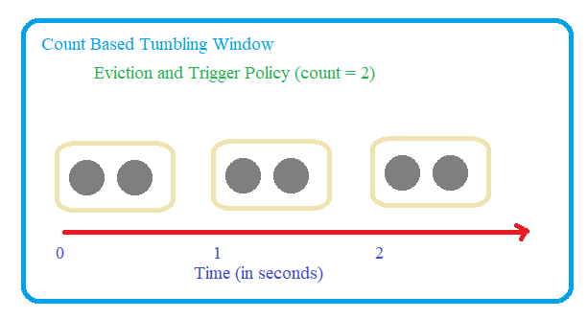
Count based Tumbling Window
Trigger and eviction policies will be executed when window is full
If the eviction and trigger policies are two , when two events are accumulated in window:
Trigger will be fired , code will be executed
Window will be drained
No time constraints for window to be filled

Slide 7
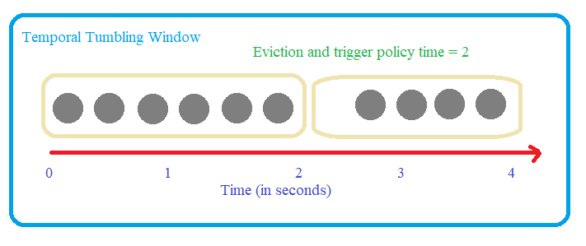
Temporal Tumbling Window
Based on time
If the eviction and trigger policy set to 2 seconds, when 2 seconds are over :
Trigger will be fired, code will be executed
Window will be drained
No constraints on number of records in window

Slide 8
Thank You!
In our next session: Joins

